Slide 1
Tour-Kenya
James Ngugi
Lawrence Magerer
Carolyne Mutua

Slide 2
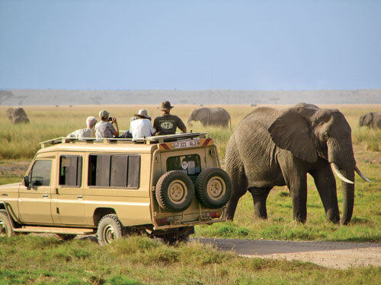
Abstract
Kenya has many tourist destination sites. With the existence of many tourist sites there are some sites that tourists may not be aware of. Therefore there is need to keep track of all tourist attraction sites .
Our proposed solution is a platform where any person who whishes to tour around Kenya can know about the various attraction sites depending on their current location.

Slide 3
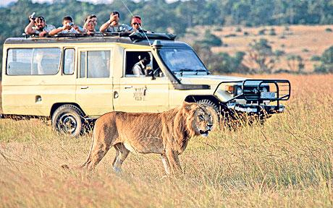
Background
Kenya is known worldwide for its diverse tourist attraction sites. There has been many improvements in the tourism sector with discovery of more tourist destination points thus we need to keep track these sites and keep both local and foreign tourists informed.
.

Slide 4

Solution
The solution to this problem is a mobile platform that enlists tourist destination sites that are close to the tourist’s current location.

Slide 5
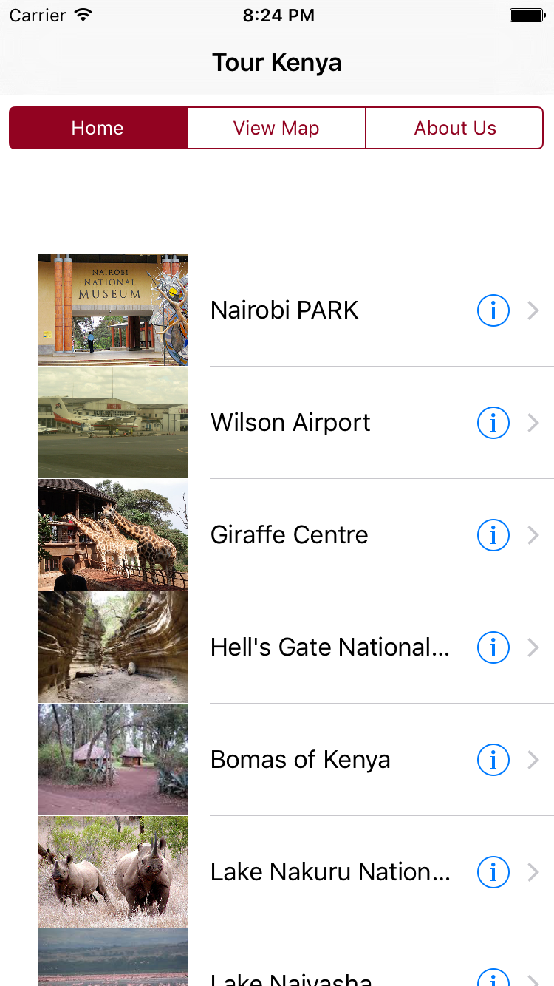
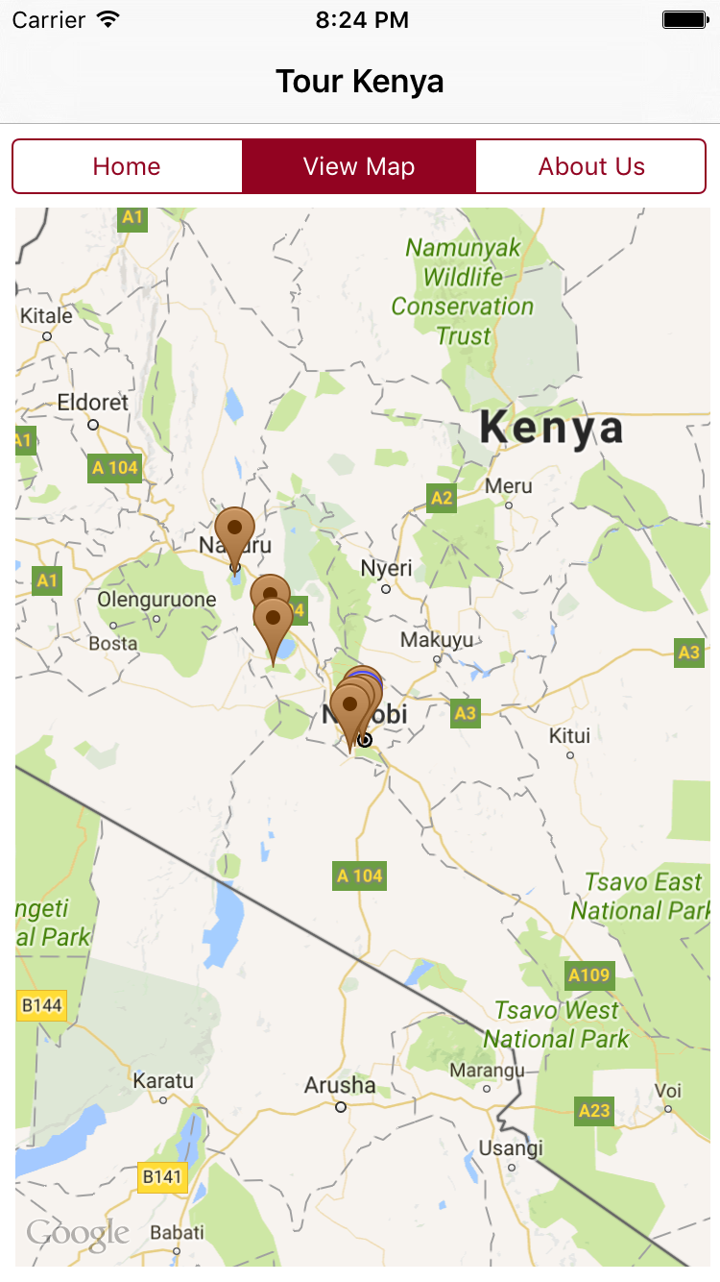
Screen Shots
Home Screen
Map Screen

Slide 6
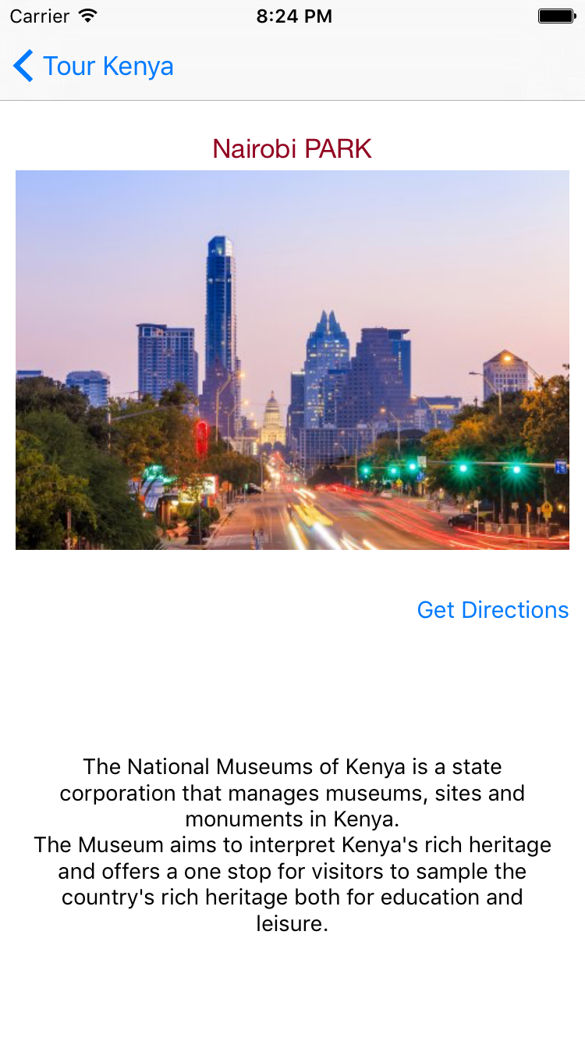
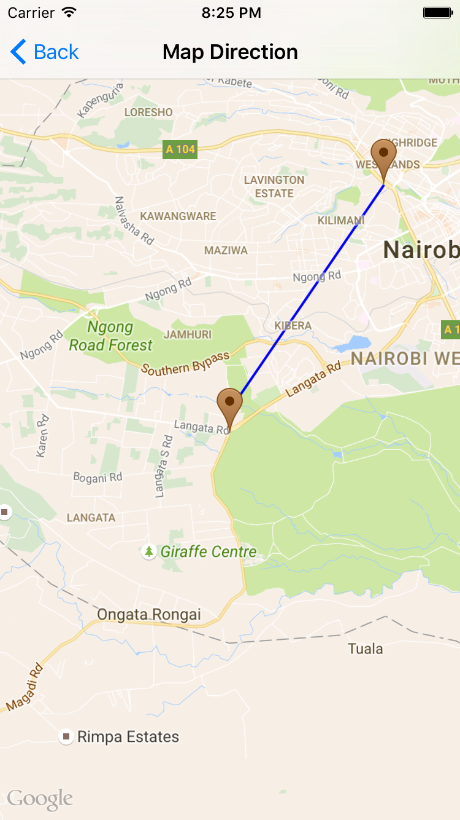
Screen Shots
Details Screen
Map Direction Screen

Slide 7
Solution Architecture

Slide 8
Thanks!
Any questions?

